Slide 1
Factors Affecting Customer Lifetime Value (CLV) of an Automobile Insurance Company
Applied Econometrics and Time Series Analysis – Group 2
1. Abhilash Nautiyal
2. Jalal-U-Din Kadernani

Slide 2

Agenda
1. Introduction
2. Literature Review
Customer Lifetime Value
Automobile Insurance
Stakeholders
Articles
Contributions
3. Data
4. Empirical Method
5. Result
6. Conclusion
Source
Features
EDA + Visualization
Method
Estimated Equation
Assumptions
Statistical Inference
Economical Inference
R-Squared
Further Observations
December 7, 2023

Slide 3

Introduction
Auto Insurance:
The global auto insurance market is a vast and continuously growing sector. As of 2021, the market size is estimated to be around $600 billion.
With the increasing number of vehicles on the road and the growing awareness of insurance benefits, the market is expected to witness further growth in the coming years.
Customer Lifetime Value (CLV):
Customer Lifetime Value (CLV) emerges as a critical metric in understanding the long-term economic value a company can expect from a customer throughout their relationship.
It quantifies customer purchase behavior, aiding in the identification and maximization of the value of valuable customers.
Stakeholders:
Academicians can use this study and further their research exploring more dimensions in the area.
Marketing and sales departments of companies can leverage the findings to tailor their strategies.
Government agencies and regulatory bodies overseeing the insurance sector could use the research to understand market dynamics and customer behavior, helping them make policy decisions.
Companies that provide CRM and data analytics solutions to the insurance industry could use these findings to enhance their product offerings.
December 7, 2023

Slide 4
Literature Review
Customer lifetime value is a powerful measure that synthesizes customer profitability and churn risk. Customer lifetime value can help companies develop customer loyalty and treatment strategies to maximize customer value.
Source: Customer Lifetime Value Prediction of Motor Insurance Company using Regression Model (2023)
The probability of selling to an existing customer is 60-70%, but for a new prospect its 5-20%. 76% of companies see CLV as an important concept for their organization, but only 42% can measure CLV accurately.
Source: Growth IQ: Get Smarter About the Choices that Will Make or Break Your Business (2018) - Tiffani Bova
Monthly premium auto, total claim amount, and coverage (no. of policies) are strongly related with CLV, so they are the main factors that reflect customer behaviors and affect CLV.
Source: Customer Lifetime Value Analysis Based on Machine Learning (2022) - Xinqian Dai
December 7, 2023

Slide 5
Data
Features:
Demographic Information (8 Variables):
Customer, State, EmploymentStatus, Gender, Income, Location.Code, Marital.Status, Education
Insurance and Policy Details (16 Variables):
Customer.Lifetime.Value, Response, Coverage, Effective.To.Date, Months.Since.Last.Claim, Months.Since.Policy.Inception, Number.of.Open.Complaints, Number.of.Policies, Policy.Type, Policy, Renew.Offer.Type, Sales.Channel, Total.Claim.Amount, Vehicle.Class, Vehicle.Size, Monthly.Premium.Auto
Key Characteristics:
Completeness: Complete dataset with 24 variables.
Variety: Spans demographic and policy attributes.
Richness: Provides insights into customer interactions and transactions.
Additional Information:
Null Values: Possible null values in the "Income" column, listed as zero.
Source:
The dataset utilized in this analysis is sourced from Kaggle: Vehicle Insurance Customer Data.
It offers comprehensive information on customer interactions and transactions, providing valuable insights into customer profiles, policies, and claims.
The dataset consists of 24 variables and 9,134 observations per variable, offering a robust foundation for analysis.
December 7, 2023
Notes:
Muneet - Talk about the Source of the data where we got it from? What is it about? How many variables and observations ?
Brandon – what are the features (variables) of the dataset ? List 2-3 demographic variables – Gender, marital status, location. Then insurance and policy details variables 2-3 of them. The key characteristics, dataset is complete, a lot of variety present and data is rich. Additionally tell that the null values are possible in the income variable and those are listed as 0.

Slide 6
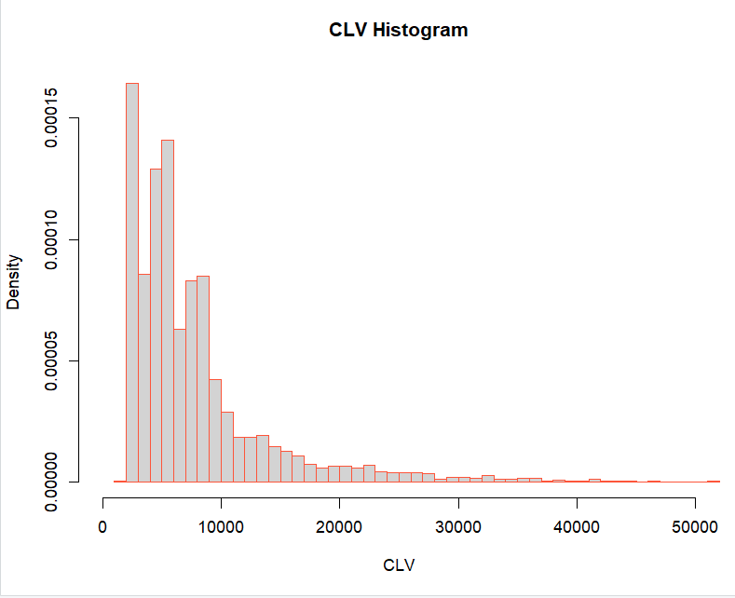
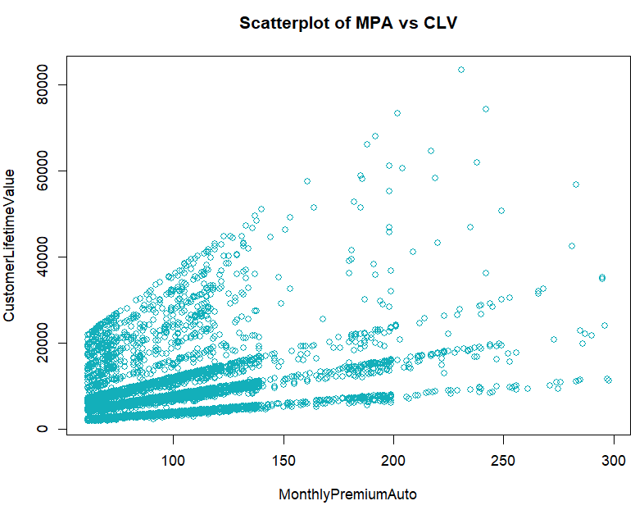
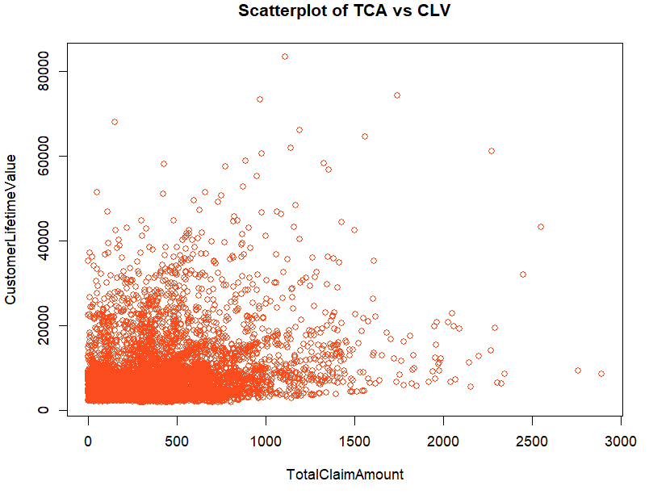
Data
Histogram of dependent variable, CLV
Plot of MonthlyPremium Auto vs CLV Corr = 0.3963
Plot of TotalClaimAmount vs CLV Corr = 0.2265
December 7, 2023
Notes:
Brandon – clv is positively skewed and when we plot scatter plots to see the correlation......

Slide 7
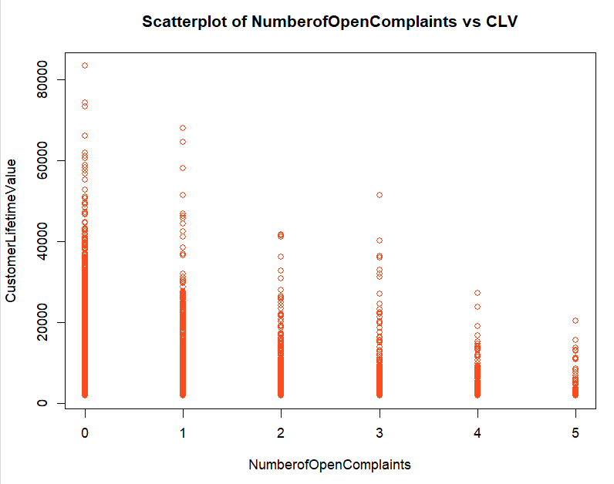
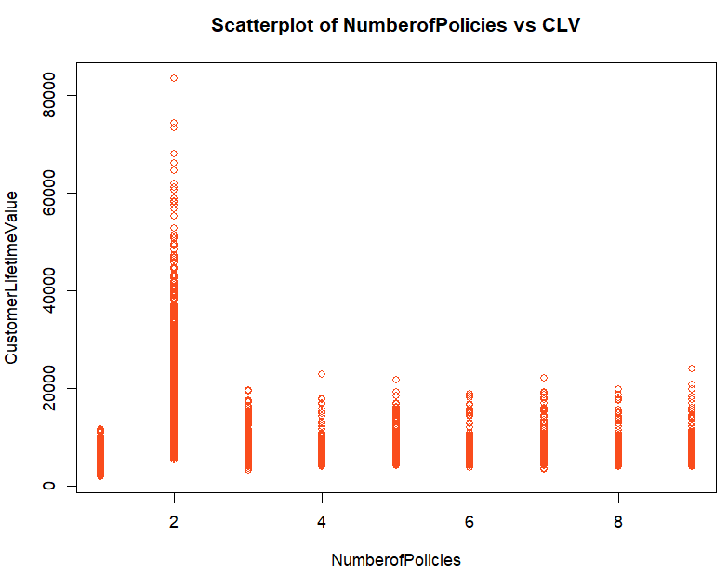
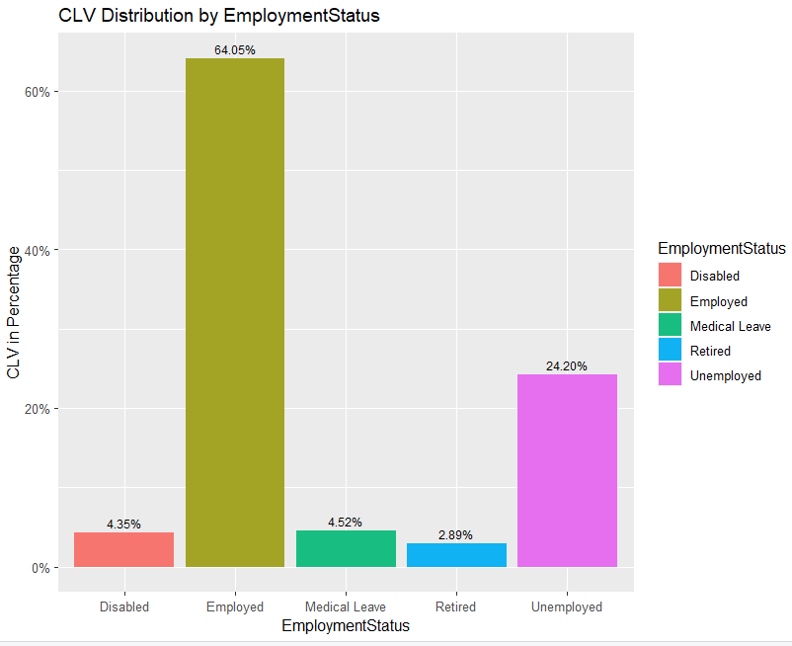
Data
Plot of NumberofOpenComplaints vs CLV Corr = -0.0363
Plot of NumberofPolicies vs CLV
Corr = 0.0220
Chart of CLV Percentage vs EmploymentStatus
December 7, 2023
Notes:
Brandon -

Slide 8
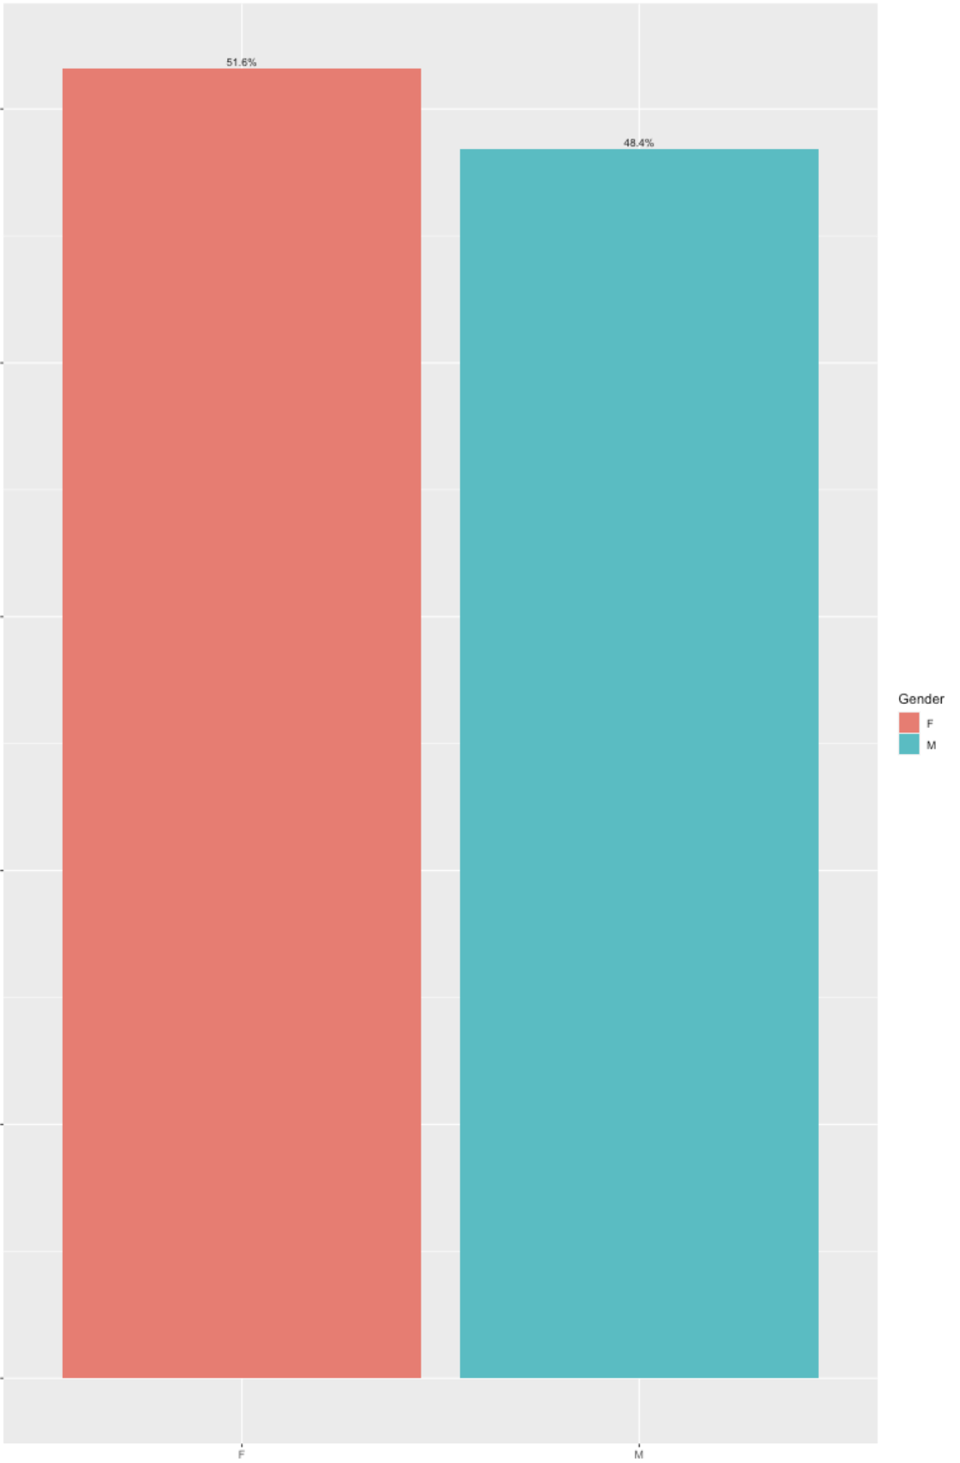
Data
Female
Male
Effect of Gender on Customer Lifetime Value (CLV)
Gender has no role to play in determining the value of a customer. Both Male and Female looks valuable.
CLV in Percentage
Gender
December 7, 2023
Notes:
Muneet - Talk about how we did EDA for all the different Categorical variables and their effects on the CLV. We then concluded what variables have what kind of effects on the CLV value. Here, then read the slide.

Slide 9
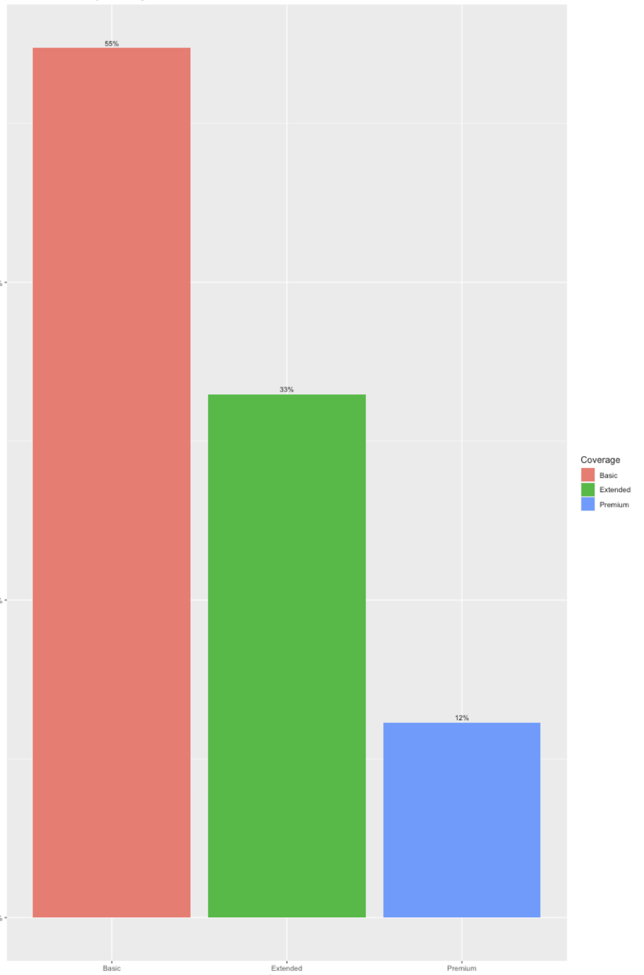
Data
Basic
Extended
Premium
Effect of Insurance Coverage on Customer Lifetime Value (CLV)
Customers who have taken Basic Insurance for their vehicles are more valuable than Extended or Premium Insurance Policyholders.
CLV in Percentage
Coverage
December 7, 2023
Notes:
Read the slide

Slide 10
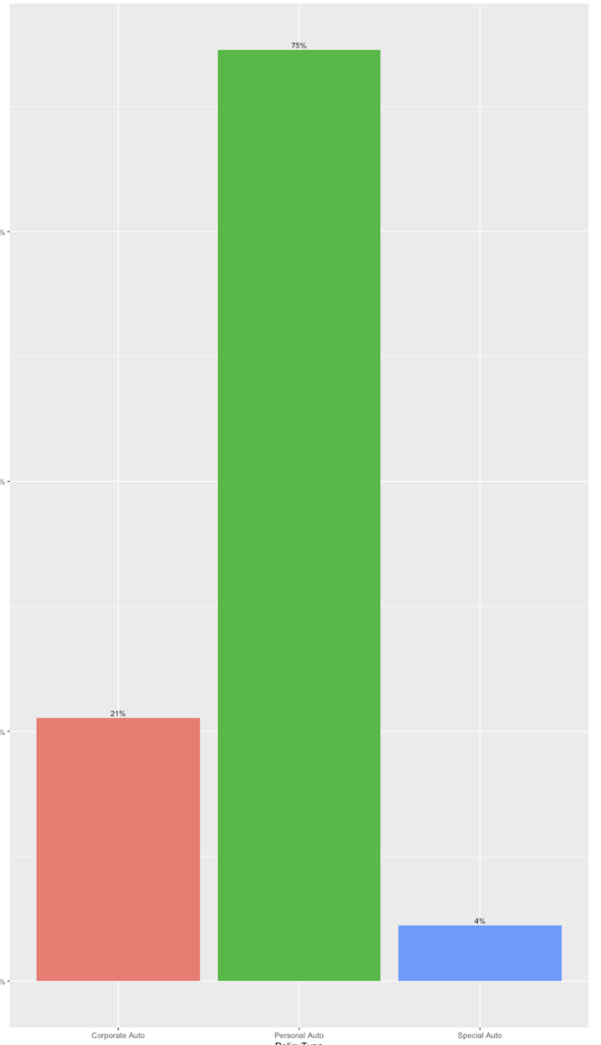
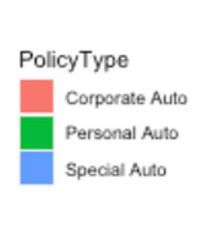
Data
Corporate Auto
PersonalAuto
Special Auto
Effect of Policy Type on Customer Lifetime Value (CLV)
Customers having their own Personal Policy are more valuable to the company than Corporate and Special Insurance policy holders.
CLV in Percentage
Policy Type
December 7, 2023
Notes:
Add here that just like these three evaluations, we checked for all the different categorical values to understand the dependance of CLV on these variables. Read the slide

Slide 11

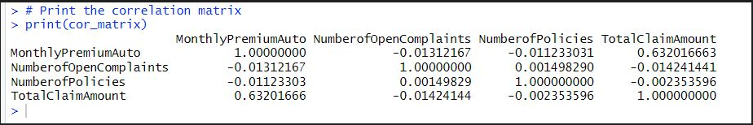
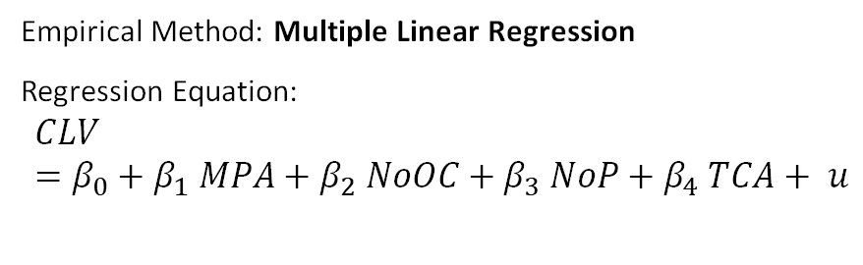
Empirical Method
Assumption MLR.1. Linear in Parameters - satisfied by the relationship of the independent variables to the dependent variables.
Assumption MLR.2. Random Sampling is satisfied by virtue of the data source and its cross-sectional nature.
Assumption MLR.3. No Perfect Collinearity is satisfied, no perfect collinearity.
Empirical Method: Multiple Linear Regression
Regression Equation:
$$CLV=β_{0}+β_{1} MPA+β_{2} NoOC+β_{3} NoP+β_{4} TCA+ u$$
Variance Inflation Factor (VIF), all values are less than 5.
December 7, 2023
Notes:
Variance inflation factor (VIF) is a measure of the amount of multicollinearity in a set of multiple regression variables

Slide 12
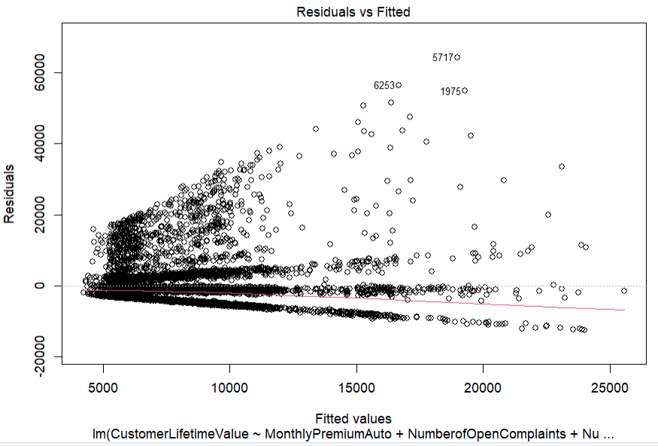

Empirical Method
Theorem 1 applies with assumptions MLR.1 through MLR.4 satisfied. OLS estimators are unbiased.
MLR.4 is reasonably satisfied to have zero conditional mean of the residuals.
Breusch-Pagan test indicates heteroscedasticity is present & MLR.5 Homoskedasticity assumption is not satisfied.
We adjusted our standard errors to remain robust against heteroscedasticity using the heteroskedasticity-robust standard errors method,
This method is also known as White Standard Errors Method (Economist Halbert White).
December 7, 2023
Notes:
Breusch-Pagan test indicates heteroscedasticity is present & MLR.5 Homoskedasticity assumption is not satisfied.
Null Hypothesis - Homoscedasticity is present in Residuals.
Alternate hypothesis - Heteroskedasticity is NOT present in residuals.
White Standard Errors Method (Economist Halbert White) - Allows us to make more reliable inferences from the regression analysis without having to transform the data or model to achieve homoscedasticity.

Slide 13
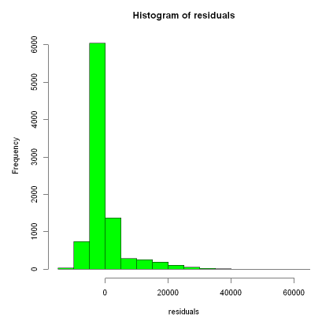
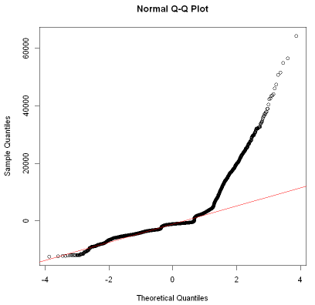
Empirical Method
MLR.6 Normality assumption is not satisfied because our histogram is positively skewed and distribution of residuals is not symmetric and deviating from the expected normal distribution.
Large sample size (9134 records) makes CLT applicable reducing the effect on regression estimators.
To achieve normality, we can remove the outliers which is approximately 10% (1035 records) of our dataset or use a more robust regression technique.
December 7, 2023
Notes:
Kolmogorov-Smirnov (K-S) test:
Null Hypothesis - Normality is present in Residuals.
Alternate hypothesis - Normality is NOT present in residuals.

Slide 14
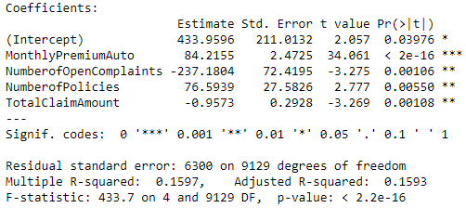
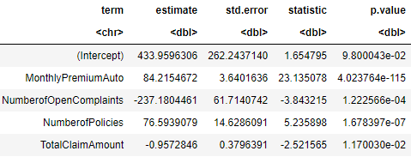
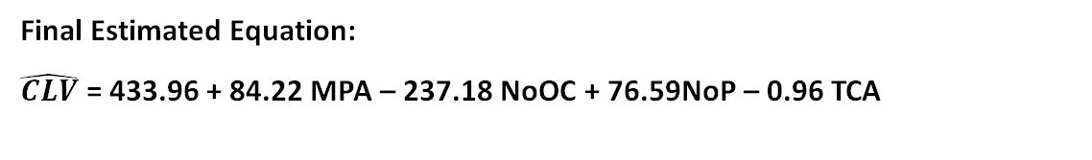
Empirical Method
Initial Regression Run
After adjusting for standard errors using the White Standard Error Method
Final Estimated Equation:
$\hat{CLV}$ = 433.96 + 84.22 MPA – 237.18 NoOC + 76.59NoP – 0.96 TCA
MPA = Monthly Premium Auto
NoOC = Number of Open Complaints
NoP = Number of Policies
TCA = Total Claim Amount
(262.24) (3.64) (61.71) (14.62) (0.38)
n = 9134, R-squared = 0.1597, Adjusted R-squared = 0.1593.
December 7, 2023

Slide 15
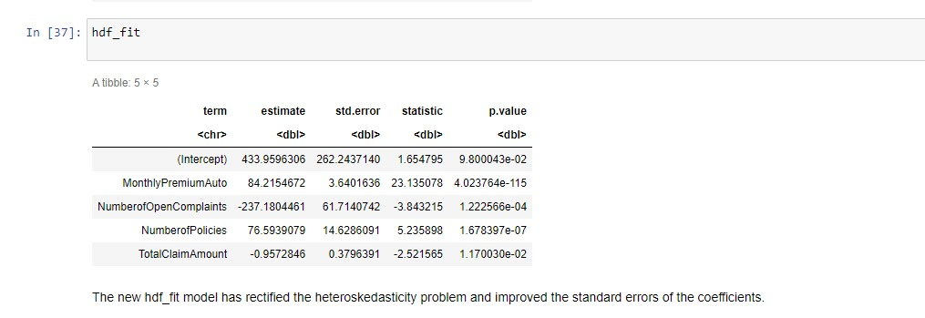
Results
​
CLV = 433.96 + 84.22 MPA - 237.18NoOC + 76.59NoP - 0.96TCA
Statistical Inference
In all analyzed cases, the p-values were found to be extremely small (p<0.001), providing robust evidence against the null hypothesis.
This indicates a high level of statistical significance and supports the conclusion that there are meaningful and substantial effects in our data.
As such, we reject the null hypothesis in favor of the alternative hypothesis at 1% significance level, affirming the validity of our findings.
December 7, 2023

Slide 16
Results
Economical Inference
MonthlyPremiumAuto : One unit increase in MonthlyPremiumAuto will increase CLV by 84.22. Companies offering competitive monthly premiums tend to foster customer loyalty by providing cost-effective and value-driven insurance solutions.
NumberofOpenComplaints : One unit increase in NumberofOpenComplaints will significantly decrease CLV by 237.18. Companies with fewer customer complaints are more likely to maintain loyalty, reflecting a commitment to service quality and customer satisfaction in the insurance industry.
NumberofPolicies : One unit increase in NumberofPolicies will increase CLV by 76.59. The Company offering more number of policy types will attract customers for a long period of time.
TotalClaimAmount : One unit increase in TotalClaimAmount will decrease CLV by 0.96. Companies with lower total claim amounts are more likely to retain customer loyalty, as reduced claim costs signal both cost-effectiveness and efficient risk management.
December 7, 2023

Slide 17
Conclusion
Further Observations
R-squared
Targeted Customer Segmentation:
Focusing on educated, married, employed customers residing in urban areas with mid-size vehicles is recommended to increase CLV. This segment demonstrates higher value, suggesting that tailored marketing efforts towards this demographic could yield enhanced customer loyalty and profitability.
Resolution of Customer Complaints and Claim Management:
Addressing customer complaints promptly and effectively is crucial. Failure to resolve open complaints and manage claim amounts in a timely manner can significantly decrease CLV. Proactive measures to enhance customer satisfaction in these areas are imperative to sustain and grow long-term customer value.
Coverage Type and Policy Type:
The analysis reveals that customers taking basic coverage type are larger than the customers choosing Extended and Premium type coverage, hence focusing on customers with basic coverage type are more valuable to the company.
Also, customers choosing personal auto policy type are of high value to the company compared to Corporate Auto and Special Auto policy types.
The R-squared (0.1597) in our model shows 15.97% of variance explained.
The adjusted R-squared (0.1593) indicates modest improvement with added predictors. This moderate explanatory power emphasizes the complexity of predicting insurance dynamics.
A very small difference in our R-squared vs Adjusted R-squared indicates the select variables are strong predictors of CLV.
For further studies, advance machine learning techniques like random forest and xgboost could be used to improve R-squared and provide a more robust model automatically treating outliers.
December 7, 2023
Notes:
We have conducted an Impact study (No Prediction or ML techniques) Checked Effects of certain variables on CLV (These variables will be important whenever we want to conduct a study on CLV in Automotive Insurance)

Slide 18
Thank You!

